Slide 1


Hand Gesture Recognition using Multi-Branch Attention Based Graph and General Deep Learning Mode
Dr. SHIN Jungpil
Vision Computing Platform Cluster
The University of AIZU, JAPAN
Notes:
The title is American Sign Language Recognition by extracting feature from Hand Pose Estimation
本日は、アメリカ手話の指文字認識についてお話ししたいと思います。
1

Slide 2

Introduction
Hand gestures are powerful human to human communication channel which convey a major part of information transfer in our everyday life.
Hand gestures are the natural way of interactions when one person is communicating with one another and therefore hand movements can be treated as a non verbal form of communication.
Hand gesture recognition is a process of understanding and classifying meaningful movements by the human hands.
Hand gesture detection systems are one of the hottest fields of research since it is of great significance in designing artificially intelligent human- computer interfaces (HCI)
Nowadays, in every sector including medical surgery room, vehicles control, sign language are using hand gesture to control them.
Rapidly increasing people’s interest toward the touchless system with hand gesture.
Notes:
I will talk about background of this research. We usually use a variety of methods to input text. One of the main examples is keyboard input. Keyboard input is the current mainstream input method and is used by many people. However, keyboards can come into contact with an unspecified number of people. It is said that many bacteria exist on a keyboard that has not been sterilized, and this is a major drawback from a hygiene standpoint. In recent years, there has been a growing demand for non-contact interfaces that allow input without the hand touching the object. For example, there have been studies using various types of devices such as wearable sensors, cameras with built-in depth sensors such as Kinect, eye movements, and even leap motion. These devices allow users to input text without touching the keyboard. They are able to input text without touching is quite hygienic, and is expected to reduce the risk of contact infections. However, sensors with depth sensors such as kinect are expensive and not very convenient to use.

Slide 3
Background
There is some uncertainty about whether the hand-crafted extracted features and rules are the optimal choice of joint global dependencies for the model.
Learning global agencies transformer has produced success in the natural language processing (NLP) field,
Better parallelizability and global dependency could be learned with minimum computational complexity among the element
The attention-based model does not require information about the intrinsic relationship among the joints.
The main drawback of these models nevertheless considers the spatial and temporal structure of the sequential hand skeleton dataset.
Recently, many researchers applied a graph-based spatial-temporal attention model to recognize skeleton-based hand gesture.
The main drawback is the lack of flexibility and sub-optimal performance because of the fixed graph structure, which may be difficult to capture variance and dynamics across different actions.
Notes:
I will talk about background of this research. We usually use a variety of methods to input text. One of the main examples is keyboard input. Keyboard input is the current mainstream input method and is used by many people. However, keyboards can come into contact with an unspecified number of people. It is said that many bacteria exist on a keyboard that has not been sterilized, and this is a major drawback from a hygiene standpoint. In recent years, there has been a growing demand for non-contact interfaces that allow input without the hand touching the object. For example, there have been studies using various types of devices such as wearable sensors, cameras with built-in depth sensors such as Kinect, eye movements, and even leap motion. These devices allow users to input text without touching the keyboard. They are able to input text without touching is quite hygienic, and is expected to reduce the risk of contact infections. However, sensors with depth sensors such as kinect are expensive and not very convenient to use.

Slide 4
Research Gap
More recently, researchers have worked to develop a dynamic hand-skeleton dynamic graph-based spatial-temporal model to recognize hand gesture.
Although they overcome the optimality problem with their model, their performance accuracy is not satisfactory.
Moreover, their model may be faced difficulties in achieving satisfactory performance or the same performance all the time because of the inefficiency of the extracted feature.
In addition, they only extracted spatial features and then temporal features, and there is no explanation about the vice versa features or if the combination of the other general deep learning features.
Notes:
I will talk about background of this research. We usually use a variety of methods to input text. One of the main examples is keyboard input. Keyboard input is the current mainstream input method and is used by many people. However, keyboards can come into contact with an unspecified number of people. It is said that many bacteria exist on a keyboard that has not been sterilized, and this is a major drawback from a hygiene standpoint. In recent years, there has been a growing demand for non-contact interfaces that allow input without the hand touching the object. For example, there have been studies using various types of devices such as wearable sensors, cameras with built-in depth sensors such as Kinect, eye movements, and even leap motion. These devices allow users to input text without touching the keyboard. They are able to input text without touching is quite hygienic, and is expected to reduce the risk of contact infections. However, sensors with depth sensors such as kinect are expensive and not very convenient to use.

Slide 5
Purpose
To overcome the challenges, we are inspired to extract all possible kinds of features from the hand skeleton dataset with the dynamic graph-based attention model
To improve the performance we are trying to extract all kind of possible feature included spatial, temporal attention and general deep learning information.
To do this study, we proposed Multi-Branch Attention Based Graph and General Deep Learning model for hand gesture recognition using a skeleton dataset to overcome the mentioned challenges.
Notes:
I will talk about background of this research. We usually use a variety of methods to input text. One of the main examples is keyboard input. Keyboard input is the current mainstream input method and is used by many people. However, keyboards can come into contact with an unspecified number of people. It is said that many bacteria exist on a keyboard that has not been sterilized, and this is a major drawback from a hygiene standpoint. In recent years, there has been a growing demand for non-contact interfaces that allow input without the hand touching the object. For example, there have been studies using various types of devices such as wearable sensors, cameras with built-in depth sensors such as Kinect, eye movements, and even leap motion. These devices allow users to input text without touching the keyboard. They are able to input text without touching is quite hygienic, and is expected to reduce the risk of contact infections. However, sensors with depth sensors such as kinect are expensive and not very convenient to use.

Slide 6
Previous study
Reference | Method | Dataset | Datasize | Accuracy(%)
Bar et al[1] | HOG+SVM | Skeleton UCF-Kinect |  | 95.94%
Hussein et al.[2] | Covariance among joint +SVM tion | MSR-A | 567 video | 90.53
Ma et al. [3] | GREN | DHG | 2700 video | 82.85
Smedt et al.[4] | ASJT | DHG | 2700 video | 82.50
Smedt et al[5] | SoCJ + HoHD + HoWR | DHG/SHREC | 2700 video | 83.07
Smedtet al [6]. | MARNN | DHG | 2700 video | 84.68
Smedt [7] | CNN+RNN | DHG | 2700 video | 85.46
Ma et. all[8] | NIUKF-LSTM | DHG | 2700 video | 84.92
Nunez [9] | CNN+LSTM | DHG | 2700 video | 85.46
YChenal. [10] | MFA-Net | DHG/SHREC | 2700 video | 85.75
Hou et al. [11] | Res-TCN | DHG/SHREC | 2700 video | 86.90
Hou et al [11] | STA-Res-TCN | DHG/SHREC | 2700 video | 86.20
Bauliah [12] | Boulahia | DHG | 2700 video | 90.48
Yan [13] | STA-GCN | DHG/SHREC | 2700 video | 91.20
Chen [4] | DG-STA | DHG/SHREC | 2700 video | 91.00
Table 1. Previous works performances at a glance including the approach and classifier used.

Slide 7
Reference
Eshed Ohn-Bar and Mohan Trivedi. Joint angles similarities and hog2 for action recognition. In Proceedings of the IEEE conference on computer vision and pattern recognition workshops, pages 465–470, 2013.
Mohamed E Hussein, Marwan Torki, Mohammad A Gowayyed, and Motaz El-Saban. Human action recognition using a temporal hierarchy of covariance descriptors on 3d joint locations. In Twenty-third international joint conference on artificial intelligence, 2013.
Chunyong Ma, Shengsheng Zhang, Anni Wang, Yongyang Qi, and Ge Chen. Skeleton-based dynamic hand gesture recognition using an enhanced network with one-shot learning. Applied Sciences, 10(11):3680, 2020.
Quentin De Smedt, Hazem Wannous, and Jean-Philippe Vandeborre. 3d hand gesture recognition by analysing set-of-joints trajectories. In International Workshop on Understanding Human Activities through 3D Sensors, pages 86–97. Springer, 2016.
Quentin De Smedt, Hazem Wannous, and Jean-Philippe Vandeborre. Skeleton-based dynamic hand gesture recognition. In Proceedings of the IEEE Conference on Computer Vision and Pattern Recognition Workshops, pages 1–9, 2016.
Quentin De Smedt, Hazem Wannous, and Jean-Philippe Vandeborre. Skeleton-based dynamic hand gesture recognition. In Proceedings of the IEEE Conference on Computer Vision and Pattern Recognition Workshops, pages 1–9, 2016.
Quentin De Smedt, Hazem Wannous, and Jean-Philippe Vandeborre. Skeleton-based dynamic hand gesture recognition. In Proceedings of the IEEE Conference on Computer Vision and Pattern Recognition Workshops, pages 1–9, 2016.
Chunyong Ma, Anni Wang, Ge Chen, and Chi Xu. Hand joints-based gesture recognition for noisy dataset using nested interval unscented kalman filter with lstm network. The visual computer, 34(6):1053–1063, 2018.
Juan C Nunez, Raul Cabido, Juan J Pantrigo, Antonio S Montemayor, and Jose F Velez. Convolutional neural networks and long short-term memory for skeleton-based human activity and hand gesture recognition. Pattern Recognition, 76:80–94, 2018.
Xinghao Chen, Guijin Wang, Hengkai Guo, Cairong Zhang, Hang Wang, and Li Zhang. Mfa-net: Motion feature augmented network for dynamic hand gesture recognition from skeletal data. Sensors, 19(2):239, 2019.
Jingxuan Hou, Guijin Wang, Xinghao Chen, Jing-Hao Xue, Rui Zhu, and Huazhong Yang. Spatial-temporal attention res-tcn for skeletonbased dynamic hand gesture recognition. In Proceedings of the European conference on computer vision (ECCV) workshops, pages 0–0, 2018.
Said Yacine Boulahia, Eric Anquetil, Franck Multon, and Richard Kulpa. Dynamic hand gesture recognition based on 3d pattern assembled trajectories. In 2017 seventh international conference on image processing theory, tools and applications (IPTA), pages 1–6. IEEE, 2017.
Sijie Yan, Yuanjun Xiong, and Dahua Lin. Spatial temporal graph convolutional networks for skeleton-based action recognition. In Thirtysecond AAAI conference on artificial intelligence, 2
Yuxiao Chen, Long Zhao, Xi Peng, Jianbo Yuan, and Dimitris N Metaxas. Construct dynamic graphs for hand gesture recognition via spatialtemporal attention. arXiv preprint arXiv:1907.08871, 20

Slide 8
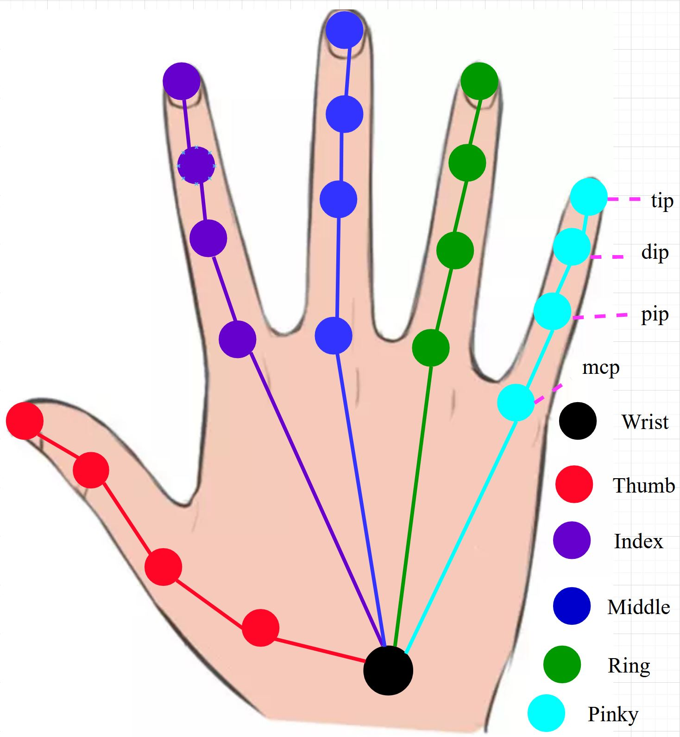
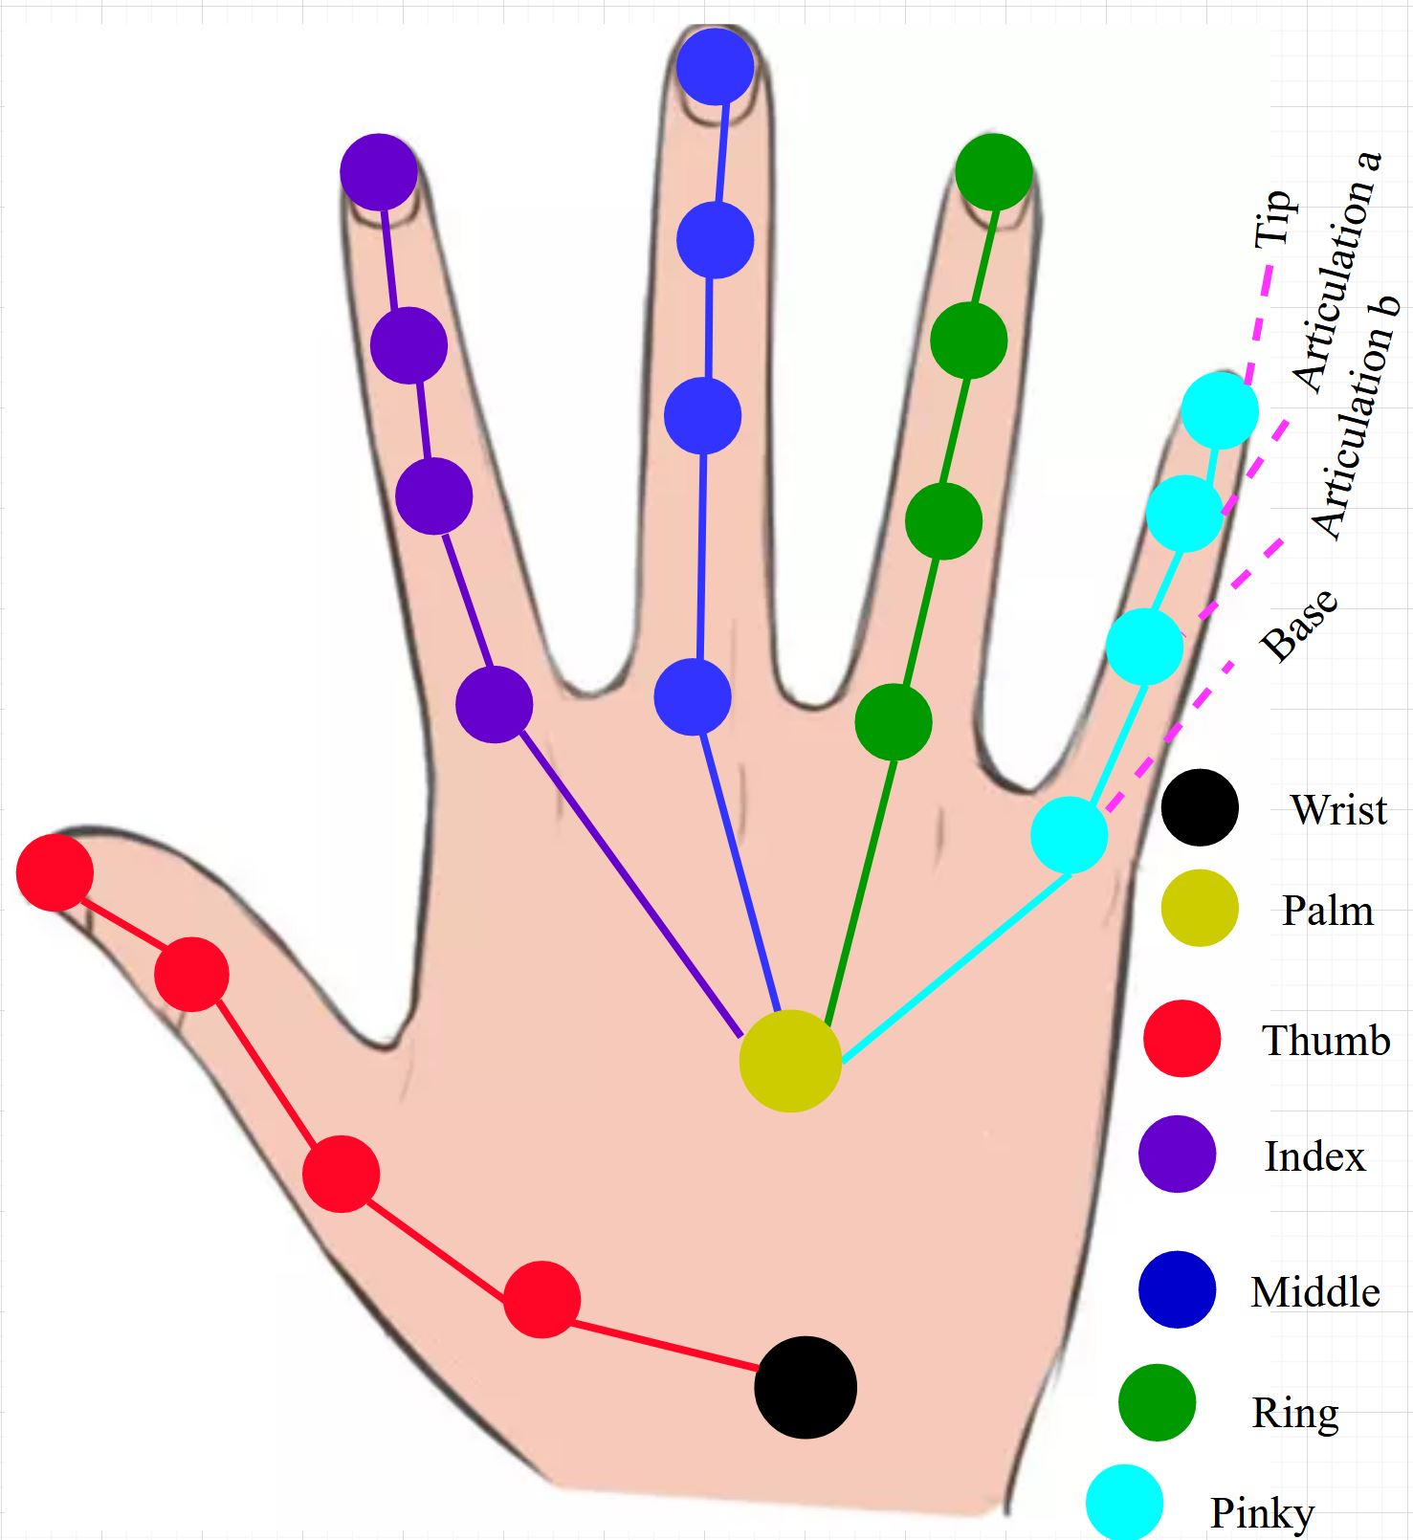
Dataset
No. | Name of the Gesture and Tag name
G-1 | Grab (G)
G-2 | Tap (T)
G-3 | Expand (E)
G-4 | Pinch (P)
G-5 | Rotation clockwise (RC)
G-6 | Rotation counter-clockwise (RCC)
G-7 | Swipe right (SR)
G-8 | Swipe left (SL)
G-9 | Swipe up (SU)
G-10 | Swipe down (SD)
G-11 | Swipe x (SX)
G-12 | Swipe + (S+)
G-13 | Swipe v (SV)
G-14 | Shake (Sh)
MSRA Dataset
17 different gestures
9 different people
600 frames for each
76500 frames in total
21 Joints from the hand
DHG Dataset
14/28 different gestures
20 different people
2800 video
20 to 70 from each video
22 hand skeleton joints
Figure 1. Twenty-one joints of MSRA dataset with right-hand skeleton.
Table 1. Gesture name for DHG and Shrec Dataet
Shrec Dataset
14/28 different gestures
20 different people
2800 video
20 to 70 from each video
22 hand skeleton
Figure 2. Twenty-two joints for the DHG and SHREC’17 dataset from the right-hand skeleton

Slide 9
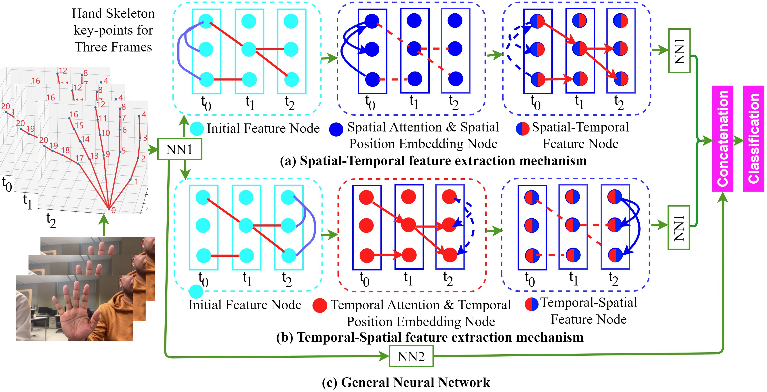
Working Flowgraph
Figure 3. Working flow Architecture

Slide 10
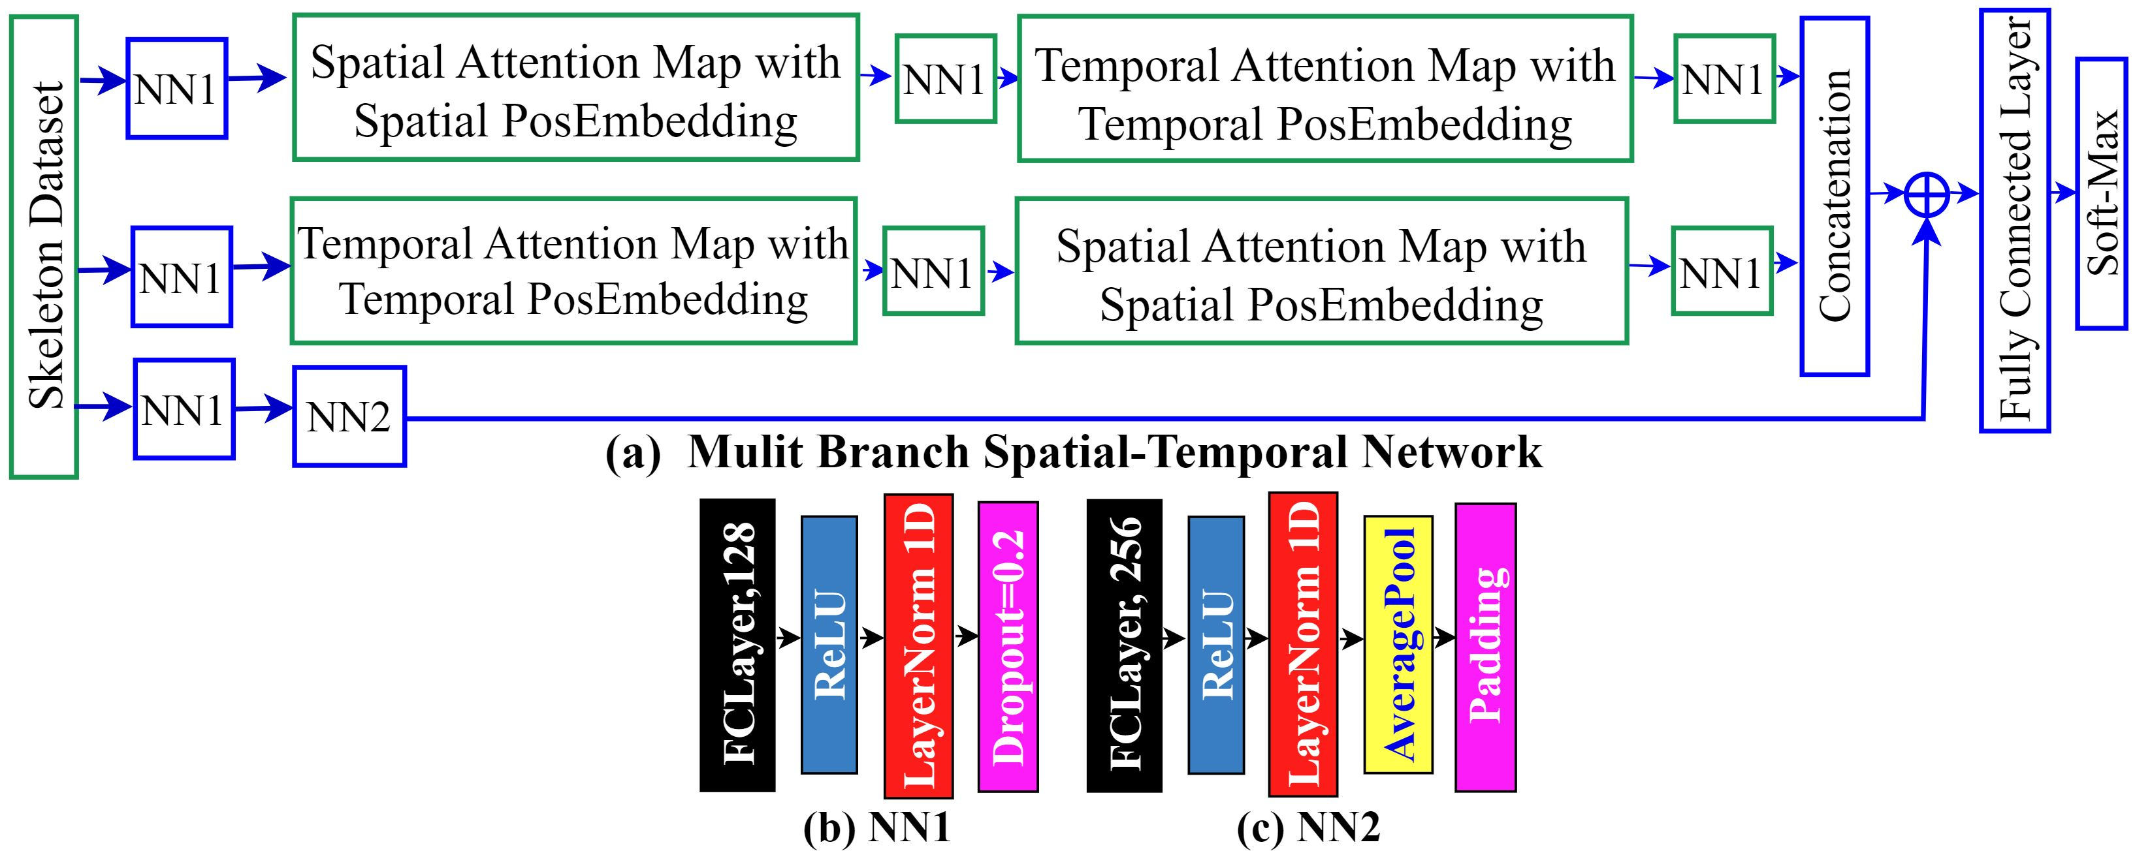
Working Flowgraph
Figure 4. Working flow Architecture in Details

Slide 11
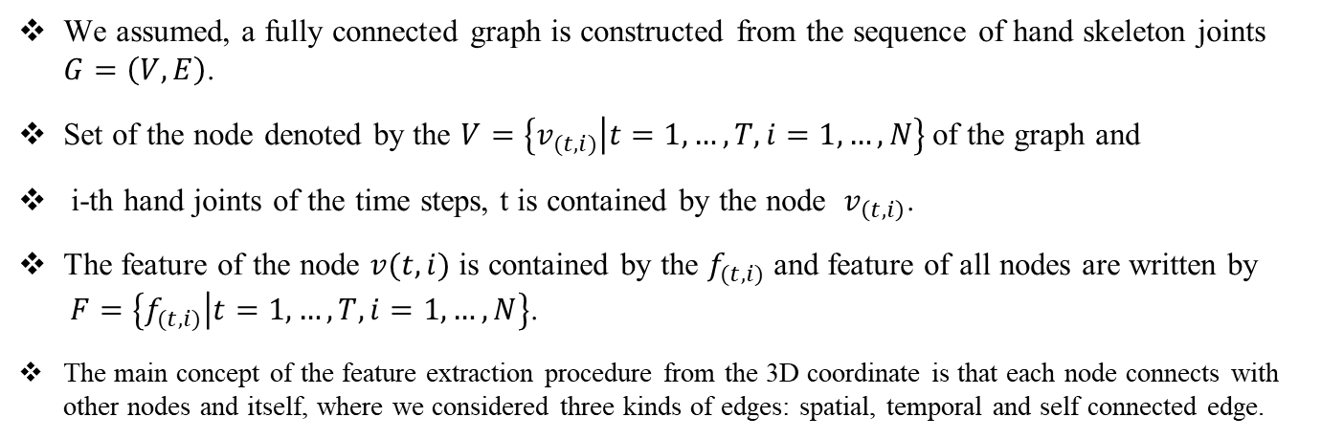
Graph Based Neural Network
Skeleton Based Graph Initialization
We assumed, a fully connected graph is constructed from the sequence of hand skeleton joints $G=\left(V,E\right)$.
Set of the node denoted by the $V=\left\{v_{(t,i)} | t=1,…,T, i=1,…,N\right\}$ of the graph and
i-th hand joints of the time steps, t is contained by the node $v_{\left(t,i\right)}$.
The feature of the node $v(t,i)$ is contained by the $f_{(t,i)}$ and feature of all nodes are written by $F=\left\{f_{(t,i)} | t=1,…,T, i=1,…,N\right\}$.
The main concept of the feature extraction procedure from the 3D coordinate is that each node connects with other nodes and itself, where we considered three kinds of edges: spatial, temporal and self connected edge.

Slide 12

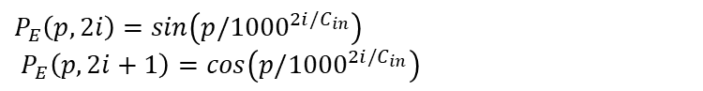
Graph Based Neural Network
Position Embedding
GRUs and LSTM sequentially process the input,
our architecture is one kind of transformer that will not process the skeleton joint sequentially.
We used positional embedding here to maintain the sequence of the joint information
$P_{E}\left(p, 2i\right)=sin\left(p/{1000}^{2i/C_{in}}\right)$
$P_{E}\left(p, 2i+1\right)=cos\left(p/{1000}^{2i/C_{in}}\right)$
$P_{E}\left(p, 2i\right)$ represent the sin function position encoding for the odd index,
$P_{E}\left(p, 2i+1\right)$ represent the cos function position encoding for the odd index,

Slide 13
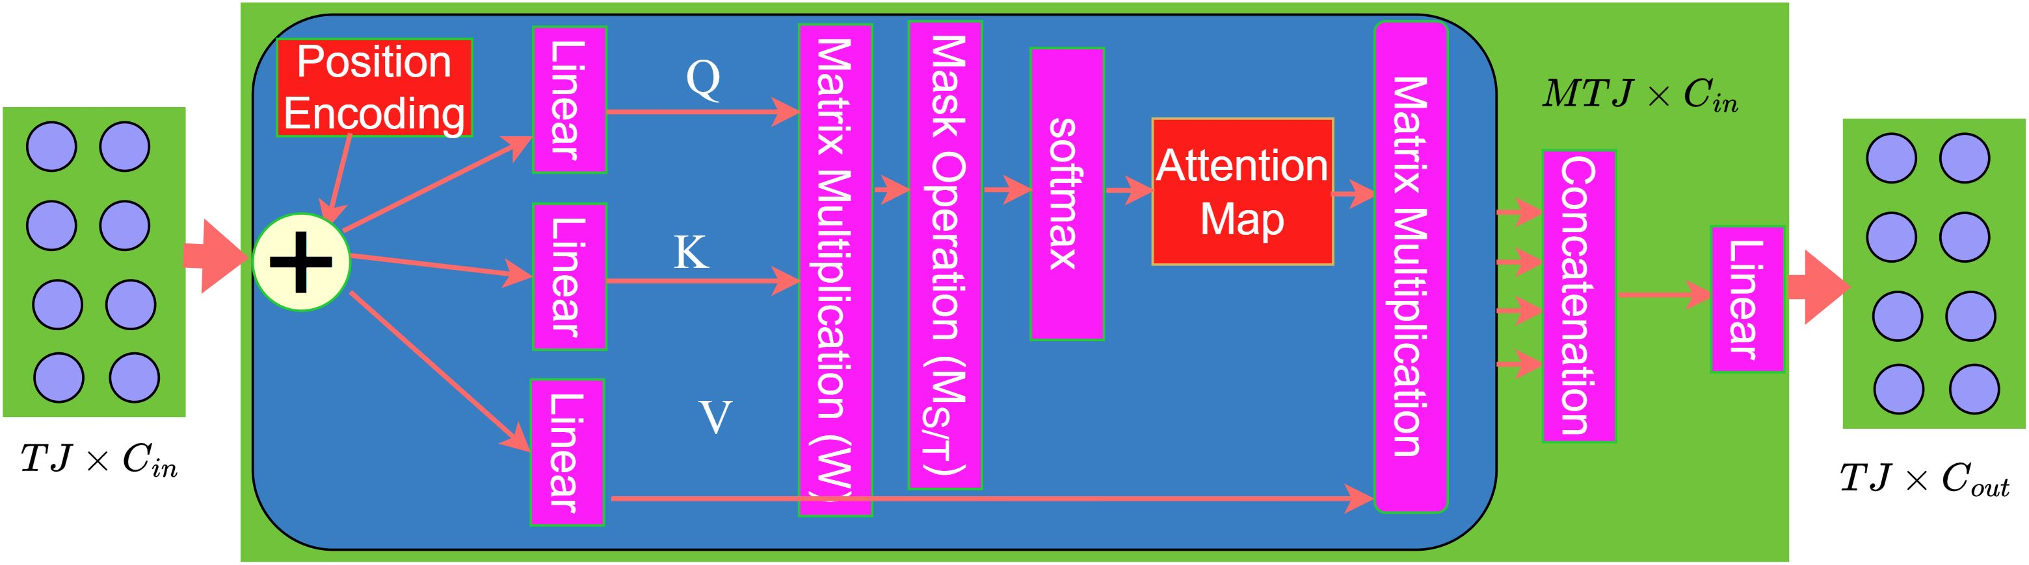
Graph Based Neural Network
Spatial-Temporal Attention Module
We applied the fully-connected layer for mapping query, key and value vectors with the input The weights metrics of the spatial or temporal edge is calculated in two stages.
simultaneously calculates the dot-product between the query and the key vectors.
Using a SoftMax activation function normalize the output of the dot product.
We block the temporal domain information passing by assigning 0 weights for all temporal edges to consider spatial attention and vice versa.
Figure 5. Working flow Architecture in Details
Main idea of spatial attention is to calculate the relationship between two nodes and information passing among the nodes within the same time steps.
M times for producing the multi-head attention of spatial or temporal domain, which is considered as multiple feature vectors.
Finally, all the attention head outputs concatenated and produced attention features

Slide 14
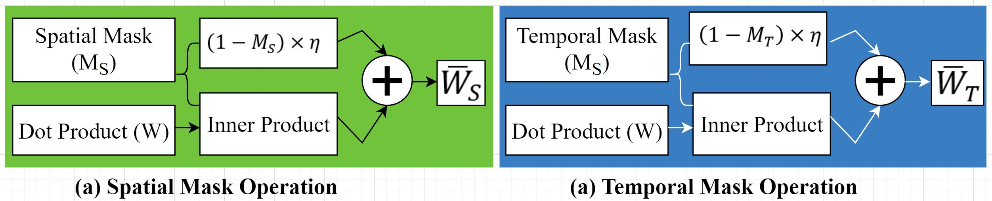
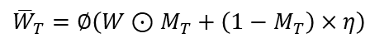

Graph Based Neural Network
Spatial-Temporal Mask Operation
Spatial and temporal masking operation used to cut down the computational cost.
Each block mask operator assigns 1 for the spatial position and 0 for others.
Figure 6. Spatial-Temporal mask operation.
Spatial Mask Operator denoted my Ms and Temporal Mask Operator denoted by Mt
${\overline{W}}_{S}=∅\left(W⊙M_{S}+\left(1−M_{S}\right)×η\right)$
${\overline{W}}_{T}=∅\left(W⊙M_{T}+\left(1−M_{T}\right)×η\right)$

Slide 15
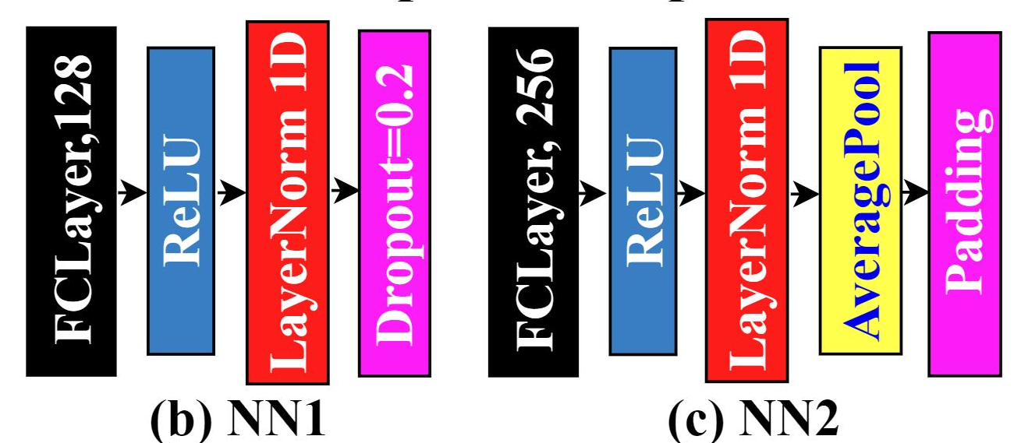
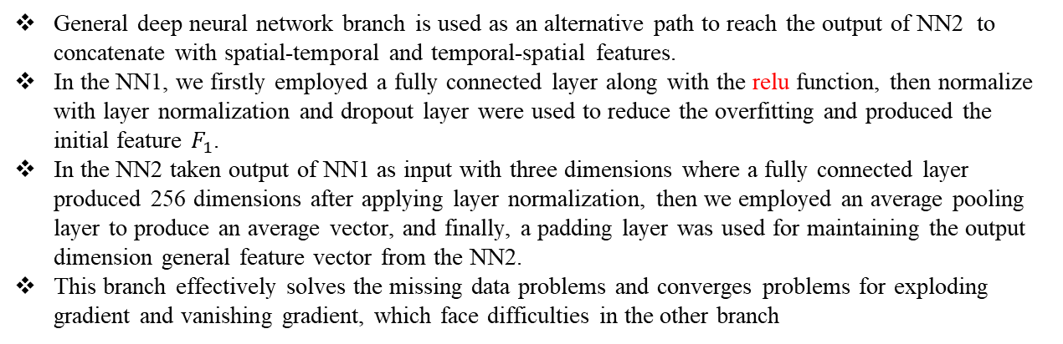
General Deep Neural Network Branc
General deep neural network branch is used as an alternative path to reach the output of NN2 to concatenate with spatial-temporal and temporal-spatial features.
In the NN1, we firstly employed a fully connected layer along with the relu function, then normalize with layer normalization and dropout layer were used to reduce the overfitting and produced the initial feature $F_{1}$.
In the NN2 taken output of NN1 as input with three dimensions where a fully connected layer produced 256 dimensions after applying layer normalization, then we employed an average pooling layer to produce an average vector, and finally, a padding layer was used for maintaining the output dimension general feature vector from the NN2.
This branch effectively solves the missing data problems and converges problems for exploding gradient and vanishing gradient, which face difficulties in the other branch
Figure 7. General Deep Neural Network.

Slide 16
Performance result
We implemented our architecture in the PyTorch platform in the NVIDIA GPU 8GB machines in the study. We randomly selected eight frames for each video as the input.
we subtract every input frame sequence by the first frame palm position based on the previous work; then, we employed some data augmentation techniques by following previous work like shifting, scaling, time interpolation and adding noise.
We used all three datasets to evaluate our model with a cross validation procedure namely leave-one-out cross-validation (LOOCV). n-1 subject information for training for each experiment and the remaining subject for testing.
Subject name | Accuracy (%)
Subject-1 | 100
Subject-2 | 94.11
Subject-3 | 94.11
Subject-4 | 94.11
Subject-5 | 100
Subject-6 | 94.17
Subject-7 | 88.24
Subject-8 | 100
Subject-9 | 82.35
Average | 94.12
Subject name | DHG Dataset Accuracy (%) |  | SHRACE'17 Accuracy (%)
 | 14 Class | 28 Class | 14 Class | 28 Class
Subject-1 | 85.00 | 87.02 | 99.16 | 95.00
Subject-2 | 83.36 | 75.00 | 97.33 | 89.00
Subject-3 | 96.77 | 85.71 | 97.49 | 92.49
Subject-4 | 92.63 | 87.80 | 94.00 | 87.81
Subject-5 | 91.26 | 91.38 | 96.05 | 94.09
Subject-6 | 90.23 | 87.57 | 99.10 | 91.38
Subject-7 | 91.10 | 85.20 | 98.40 | 95.74
Subject-8 | 94.36 | 91.25 | 96.66 | 95.00
Subject-9 | 93.57 | 94.15 | 99.76 | 95.05
Subject-10 | 97.64 | 95.07 | 99.50 | 98.56
Table 2. Performance Accuracy for MSRA Dataset for 17 Gesture
Table 3. Performance Accuracy for DHG and Shrec

Slide 17
State of the Art Comparison
Table 4: State of the Art comparison for MSRA Dataset
Methods | 14 Gestures[%] | 28 Gestures[%]
JAHOG [15] | 83.85% | 76.53%
GREN [23] | 82.29% | 82.03%
ASJT [38] | 82.50 | 80.11
SoCJ HoHD oWR[13] | 83.07 | 80.0
MARNN[16] | 84.68 | 80.32
CNN+RNN [41] | 85.46 | 74.19
NIUKF-LSTM [26] | 84.92% | 80.44%
CNN+LSTM [17] | 85.46% | 74.19%
MFA-Net [27] | 85.75% | 81.04%
Res-TCN [28] | 86.90 | 83.60
STA-Res-TCN [28] | 89.20 | 85.00
Boulahia [29] | 90.48 | 80.48
STA-GCN [8] | 91.20 | 87.1
DG-STA [30] | 91.00 | 88.00
Proposed Method | 92.00 | 88.78
Method Name | Class | Accuracy [%]
LSTM [23] | 17 | 72.92
Green [23] | 17 | 79.17
Proposed Attention | 17 | 94.12
Method | 14 Gestures[%] | 28 Gestures[%]
HON4D [32] | 78.53 | 74.03
SMTRM [33] | 79.61 | 62.00
SoCJHoHD HoWR [14] | 88.24 | 81.90
Res-C3D [41] | 89.52 | -
MFA-Net [27] | 91.31 | 86.55
Res-TCN [28] | 91.10 | 87.3
STA-Res-TCN [28] | 93.60 | 90.70
STA-GCN [8] | 92.27 | 87.7
DG-STA [30] | 94.4 | 90.00
Proposed Method | 97.01 | 92.78
Table 5: State of the Art comparison for DHG Dataset
Table 6: State of the Art comparison for SHREC'17 dataset

Slide 18
Conclusion
We employed a attention based Multi-Branch Attention Based Graph and General Deep Learning approach for recognizing hand gestures based on the 3D hand skeleton data points in the study.
Our method provided a multi-branch graph-based deep neural network and general deep neural network model with masking operation for learning spatial and temporal domain information and produced a potential feature vector for classification.
Our proposed method achieved high performance for three datasets compared to the state-of-the-art model.
In the future, we plan to collect 3D hand skeleton information from ourselves from more gestures to develop a sign language-based communication system.

Slide 19

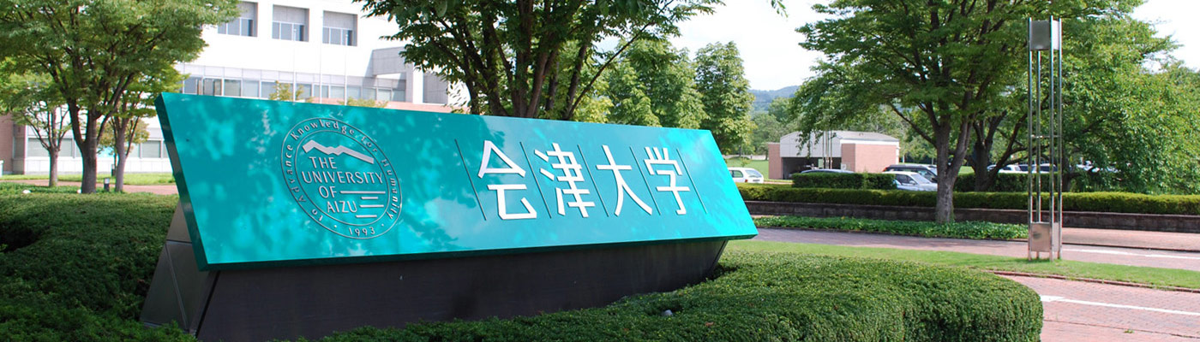
Thank you for your kind attention

